Slide 1
Hiragana &
Katakana
Japanese Writing System

Slide 2
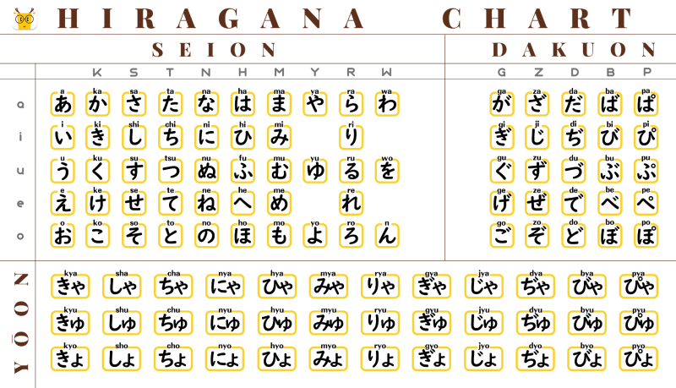
Hiragana Chart

Slide 3
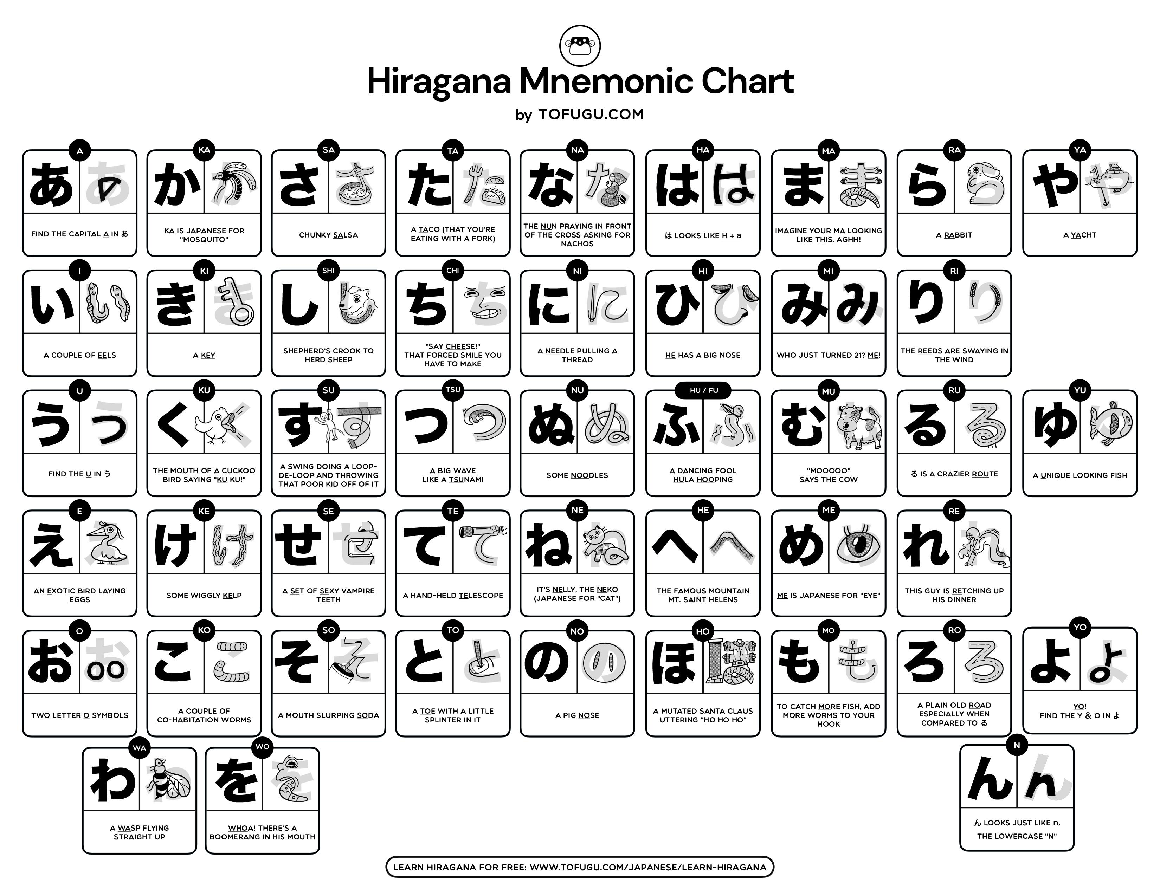

Slide 4
Let’s play a game
Hiragana Match Up Game : https://wordwall.net/resource/100255976

Slide 5
How to write it?
Marugoto E-learning page : https://a1.marugotoweb.jp/en/hiragana.php

Slide 6
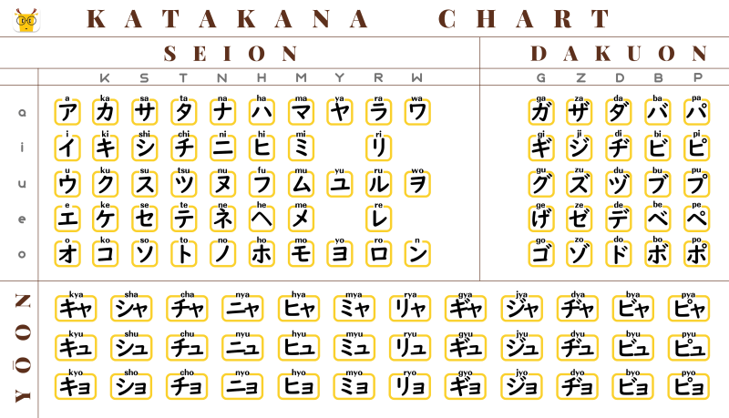
Katakana Chart

Slide 7
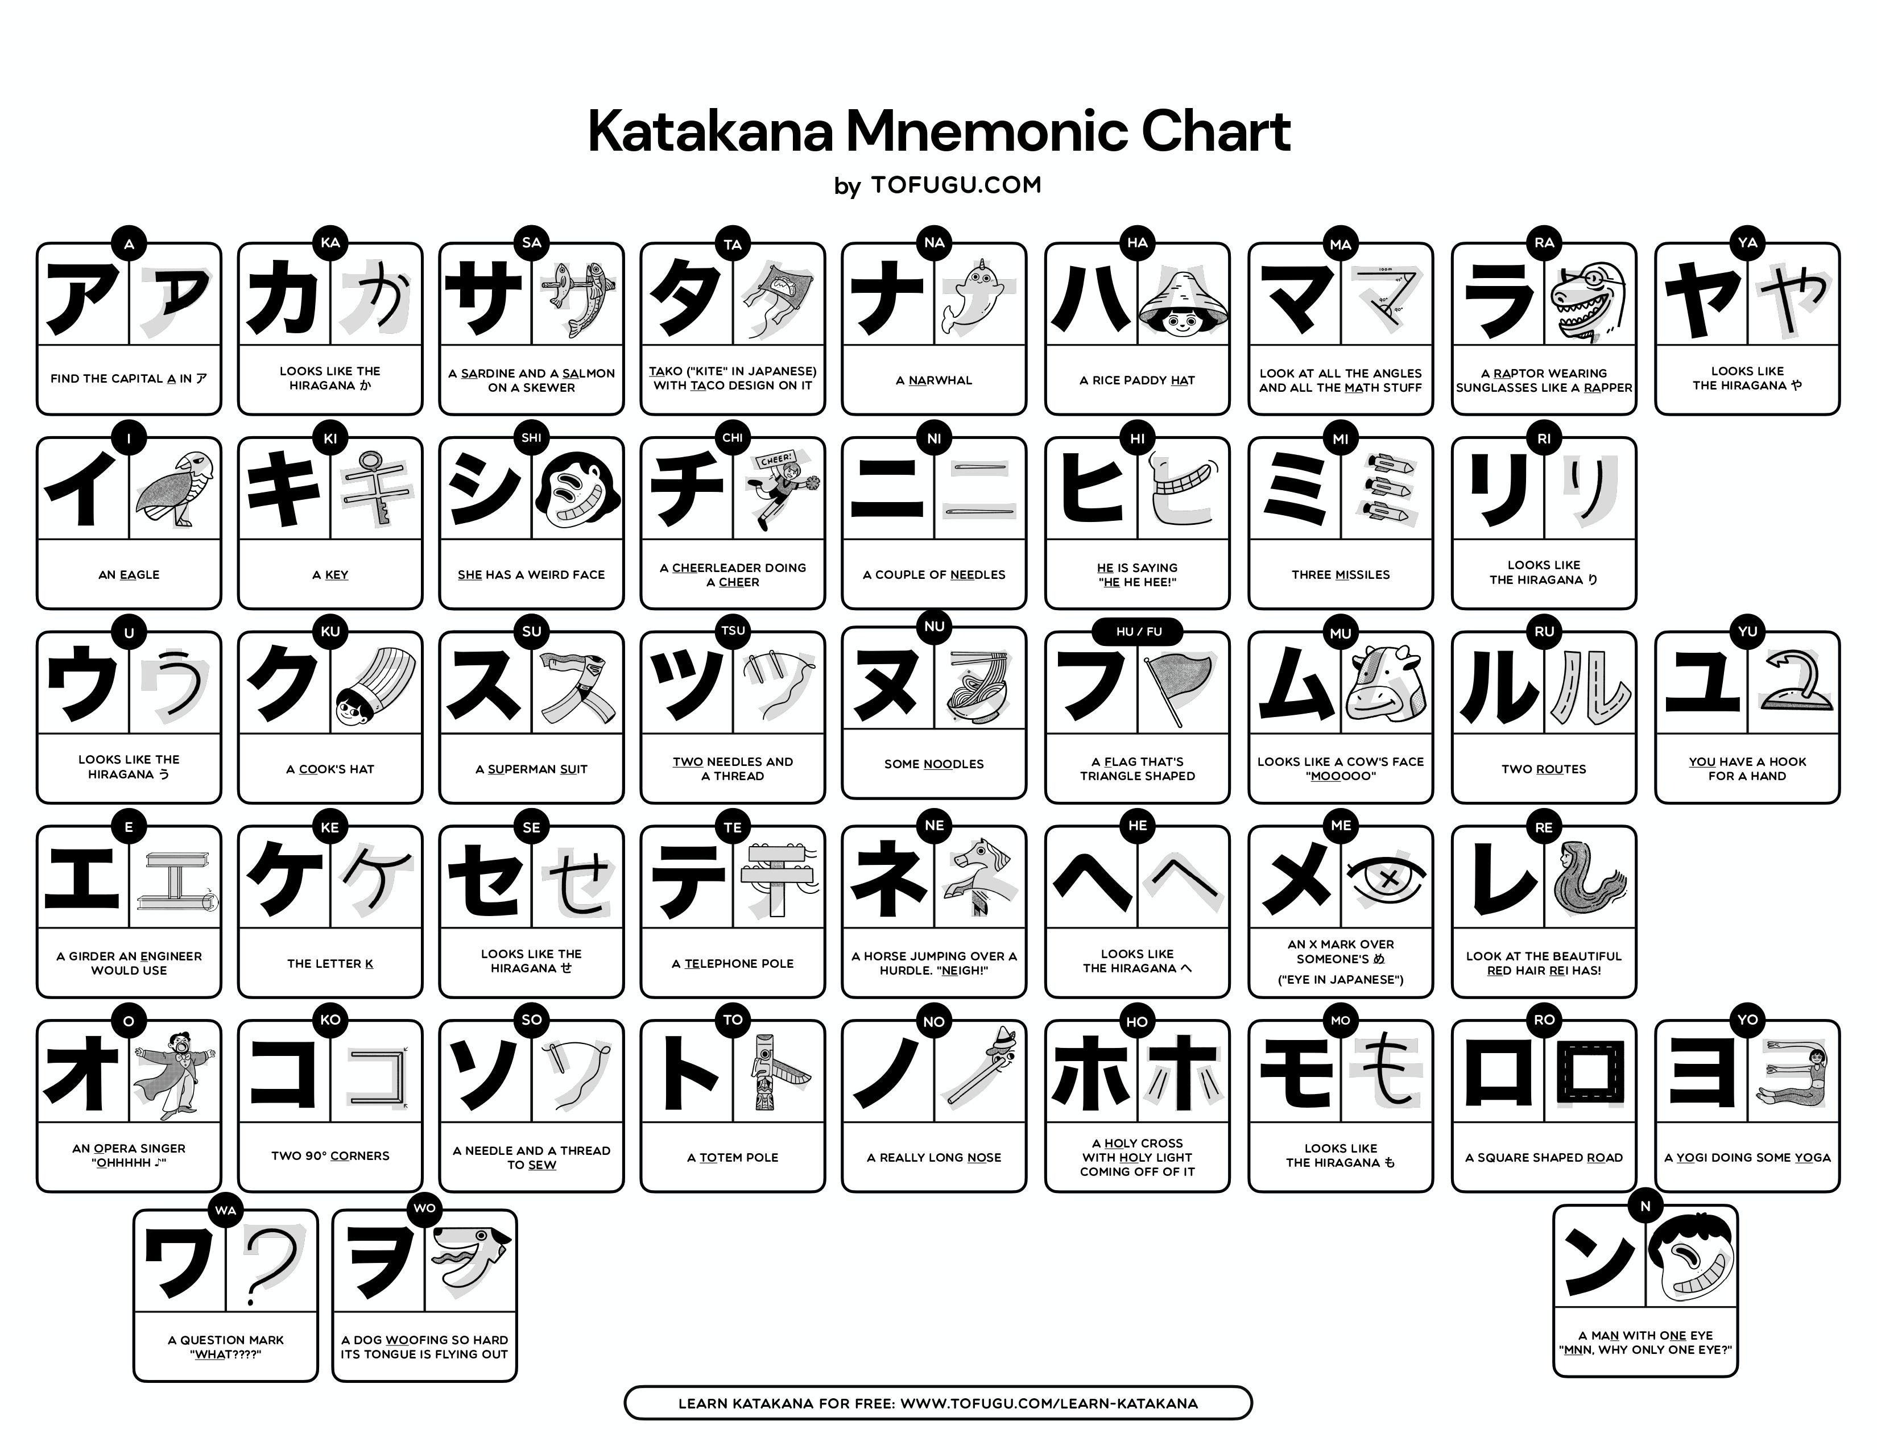

Slide 8
Let’s play a game
Katakana Match Up Game : https://wordwall.net/resource/100600986

Slide 9
How to write it?
Marugoto E-learning page : https://a1.marugotoweb.jp/en/katakana.php

Slide 11
REFERENCE
HIRAGANA MNEMONICS CHART :
https://www.tofugu.com/japanese/hiragana-mnemonics-chart/
KATAKANA MNEMONICS CHART :
https://www.tofugu.com/japanese/katakana-chart/

Slide 12


